Slide 1
GIS Map data
Living Bog

Slide 2
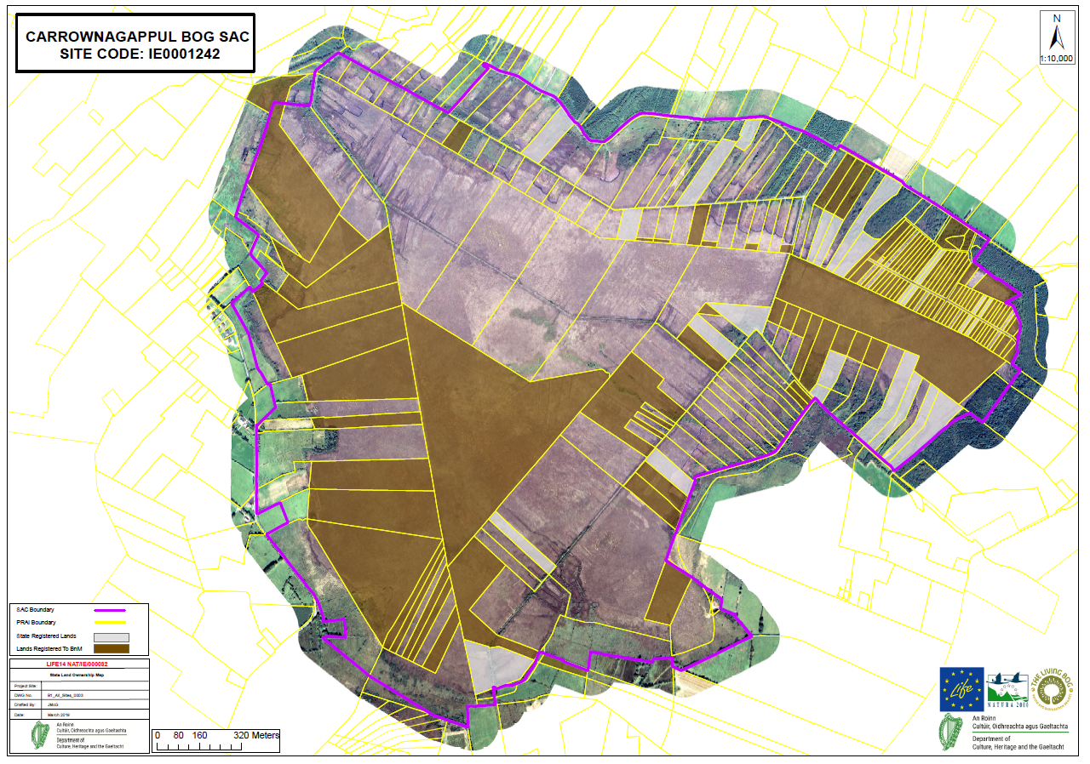
Landownership details for each site

Slide 3
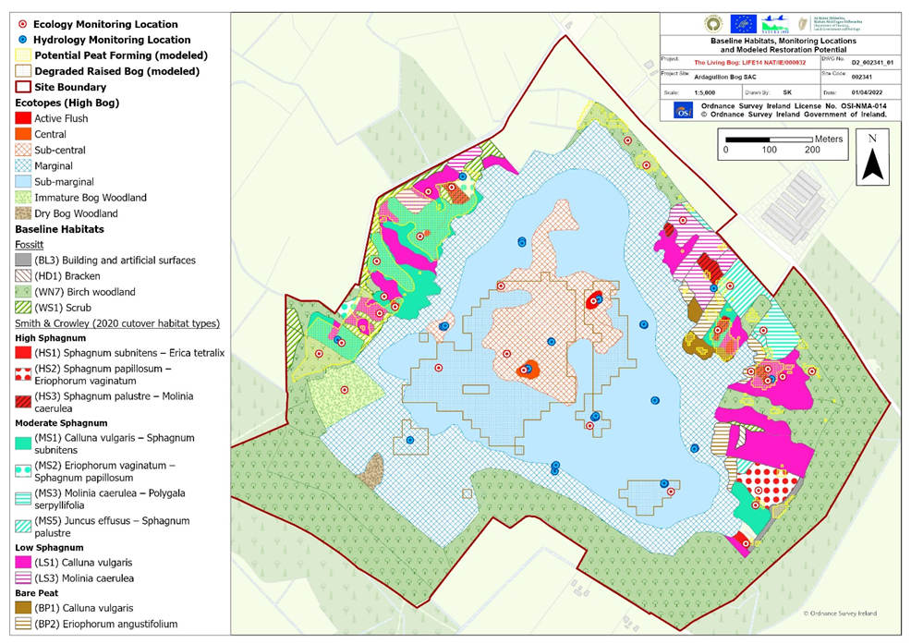
Baseline Habitats, Monitoring Locations and Modelled Restoration Potential

Slide 4
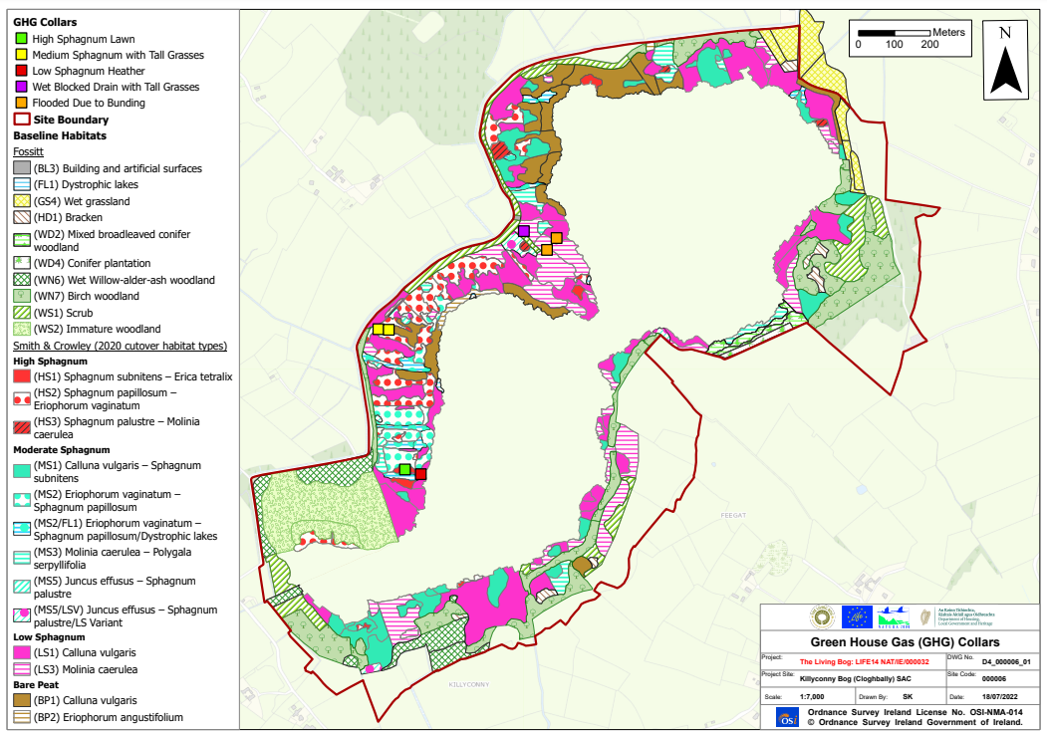
Green House Gas Collars

