Slide 1
E1 Social Media Sample Social Media & Web screenshots and analytics

Slide 2
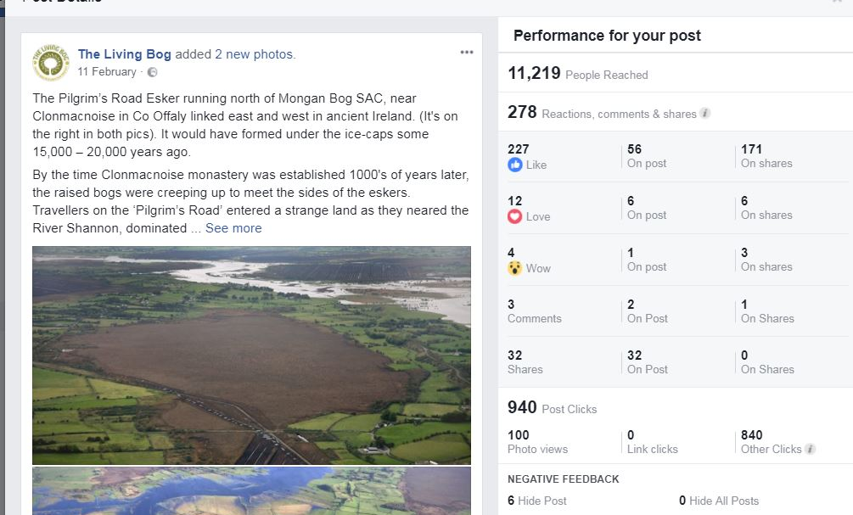
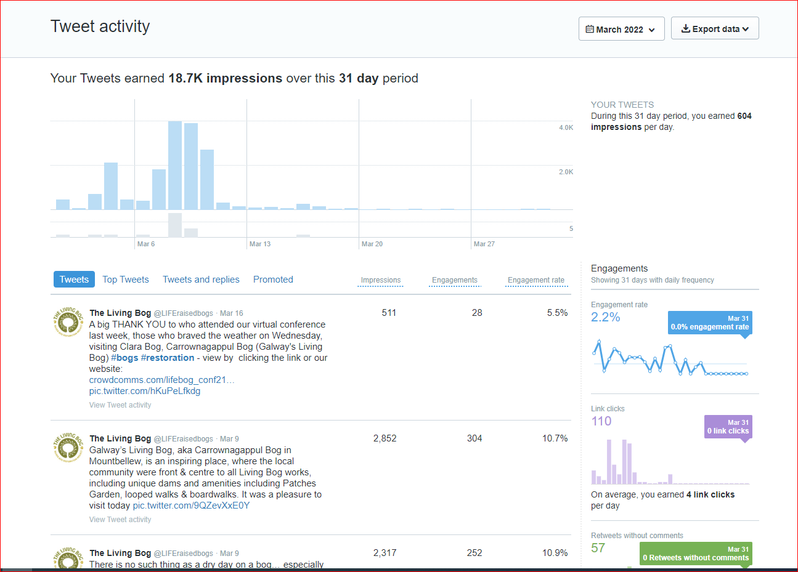
10,733 likes
(as of 31/03/22)
4,261 followers
(as of 31/03/22)
Notes:
… But it has also embraced social media and put it to the forefront of its communications… bringing the bog to phone, tablet, laptop and computer screens all over the world, and directly to the public. It’s Facebook profile grew to over 10,000 whilst its Twitter and Instagram also grew well. On Twitter, it has many “celebrity” fans, including Monty Don, and in communicating the message of bog restoration (the main aim of the project), it also communicates and comments on general peatland issues. On Twitter, despite having nearly 2k followers, some posts, like a Monty Don retweet in Jan 2018 got over 91K impressions.

Slide 3
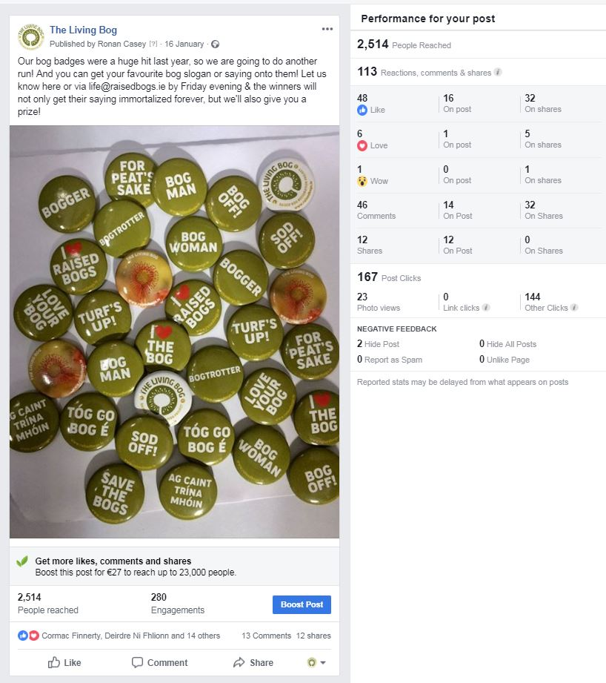
Sample Facebook post 1 – January 16, 2019
Subject matter: asking followers to come up with slogans for new badge print-run

Slide 4
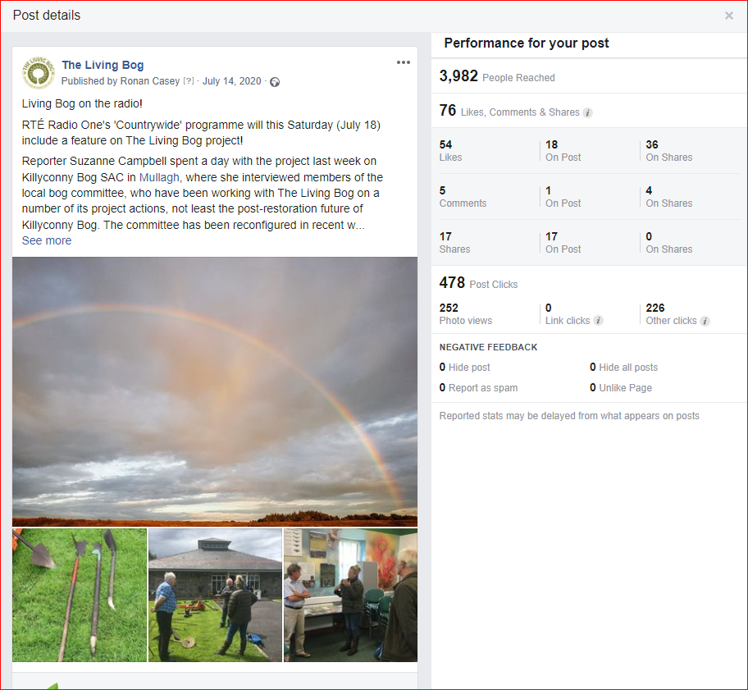
Sample Facebook post 2 – Jul 14, 2020
Subject matter: Community Media Promotion – RTE “Countrywide” broadcast

Slide 5
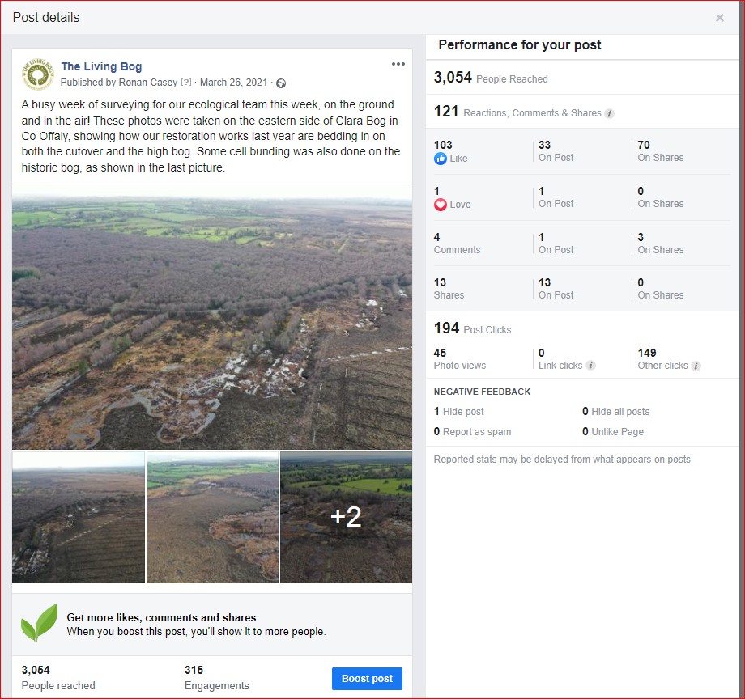
Sample Facebook post 3 – March 26, 2021
Subject matter: ecology surveying

Slide 6
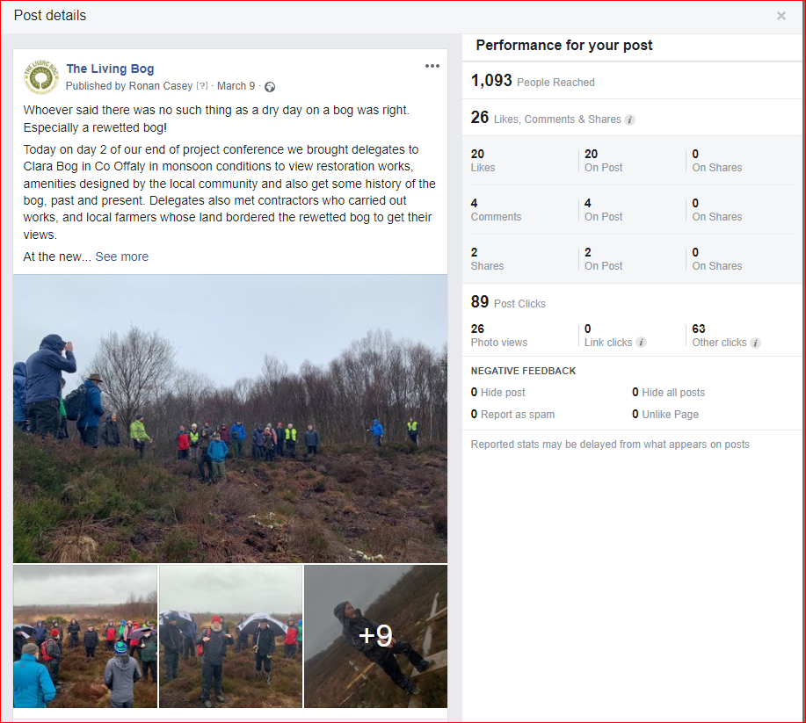
Sample Facebook post 4 – March 9, 2022
Subject matter: Conference Site visit Day 2

Slide 7
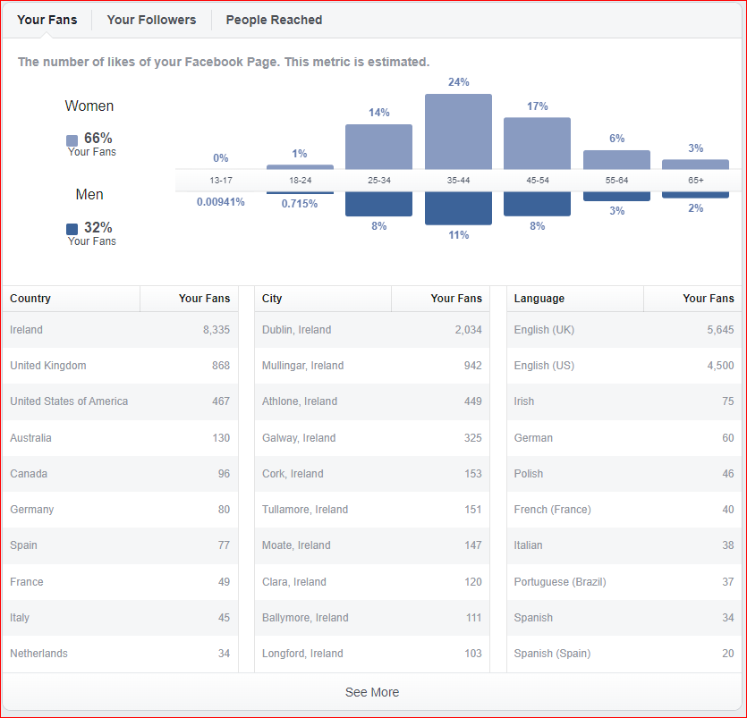
Facebook audience profile as of May 2022

Slide 8
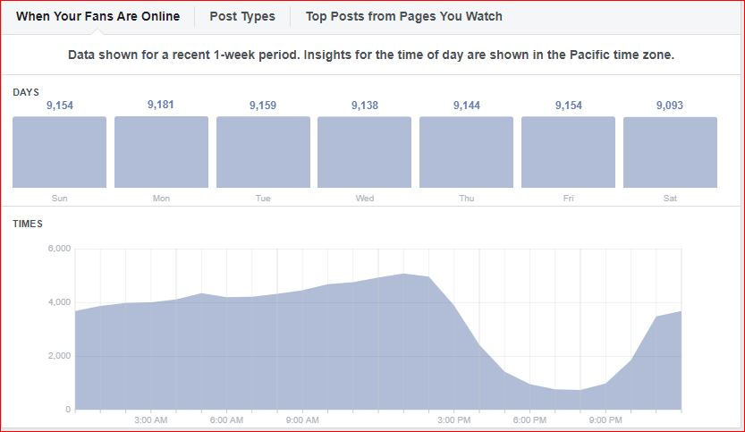
Facebook audience time online – peak time 1pm

Slide 9
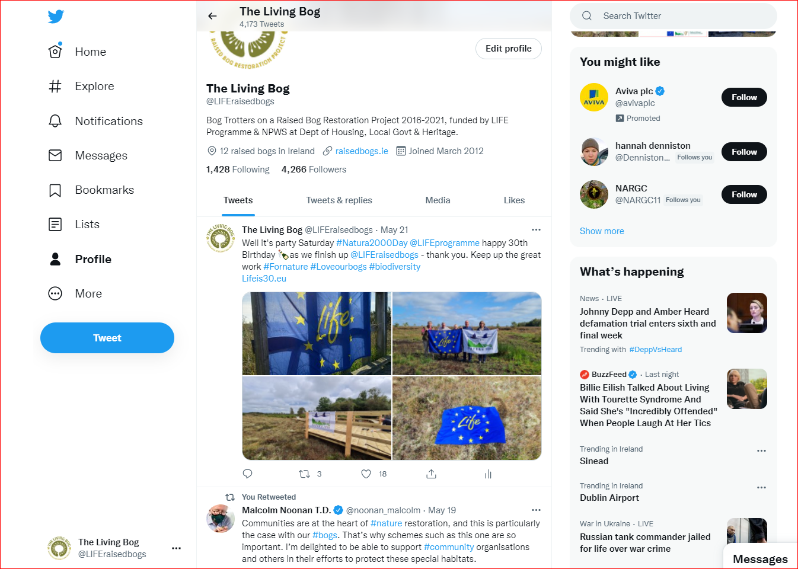
Twitter screen grab 24th May 2022

Slide 10
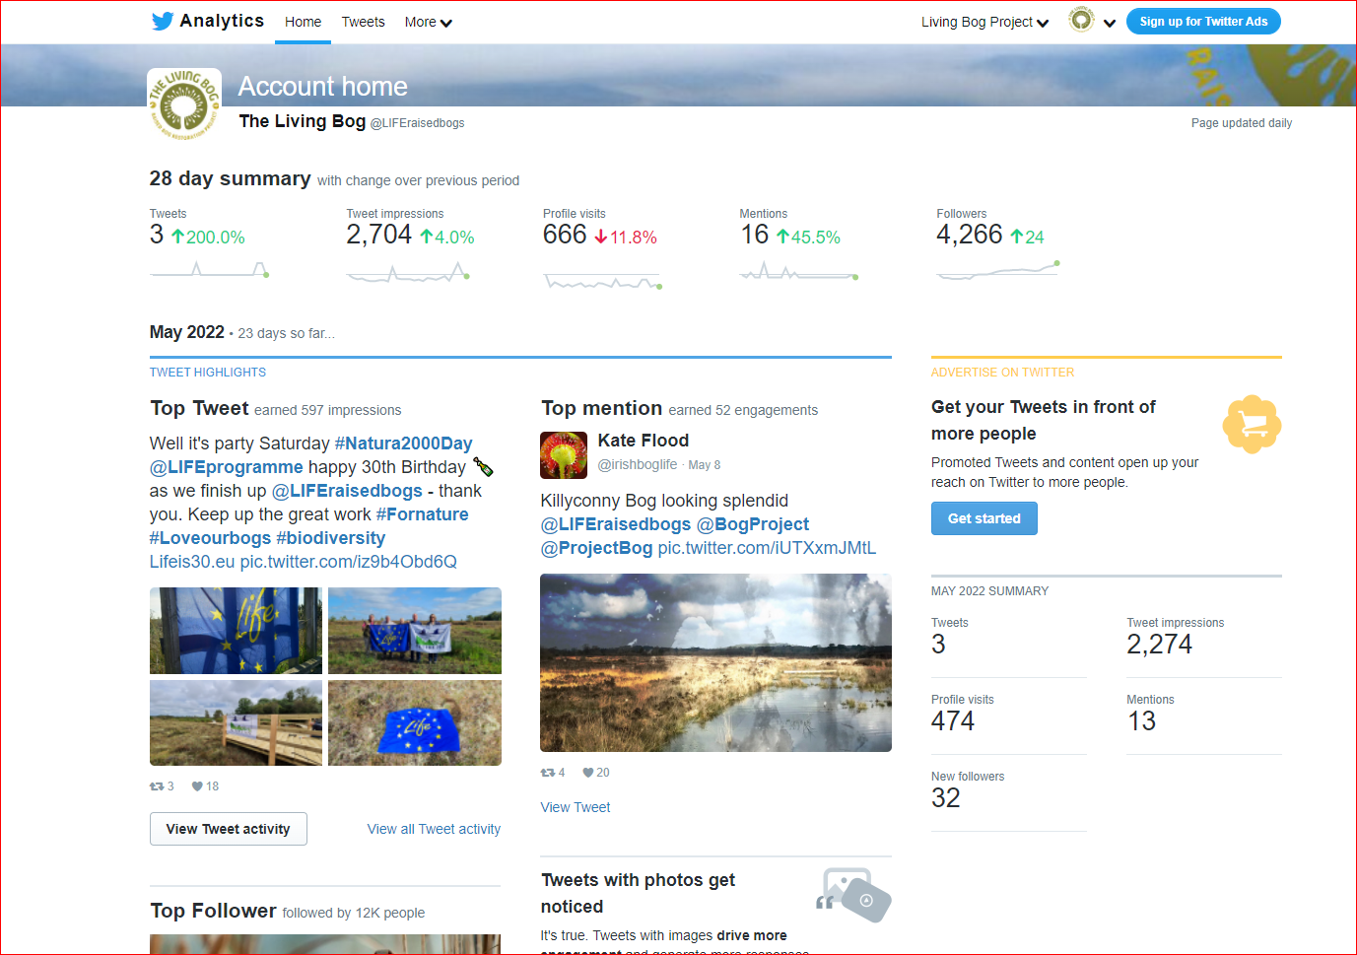
Twitter overview May 2022

Slide 11
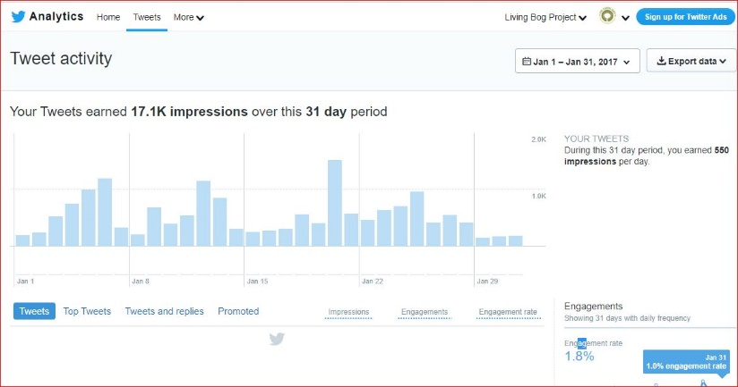
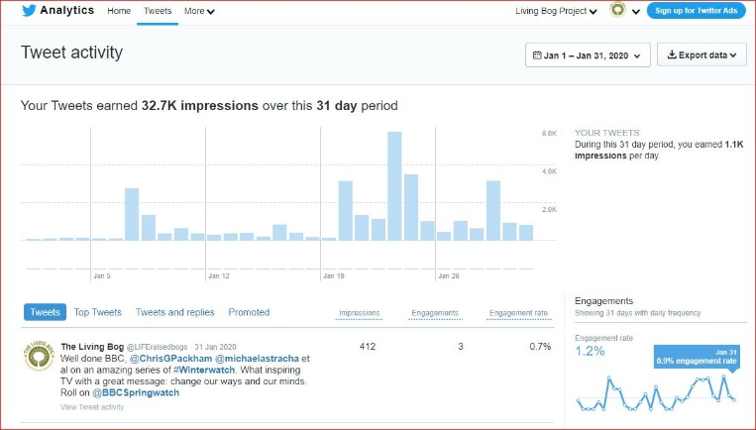
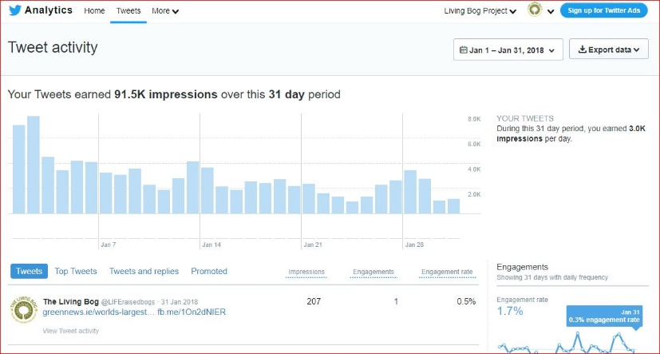
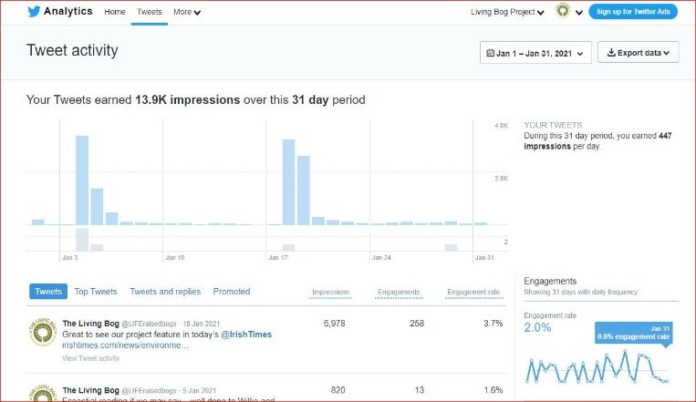
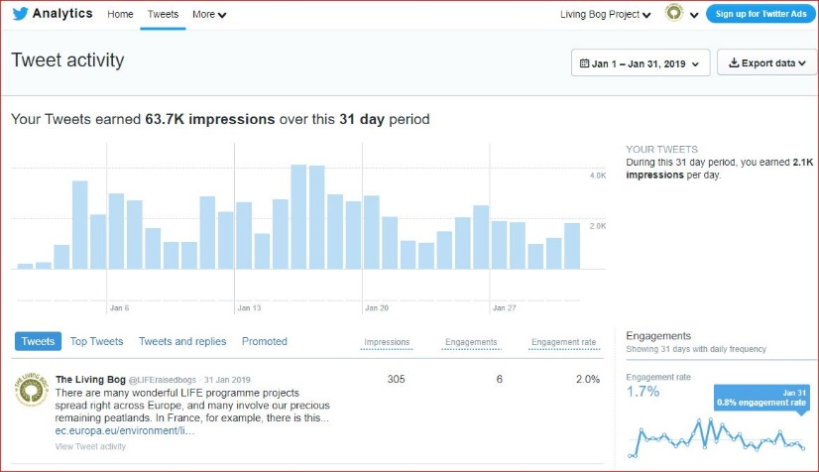
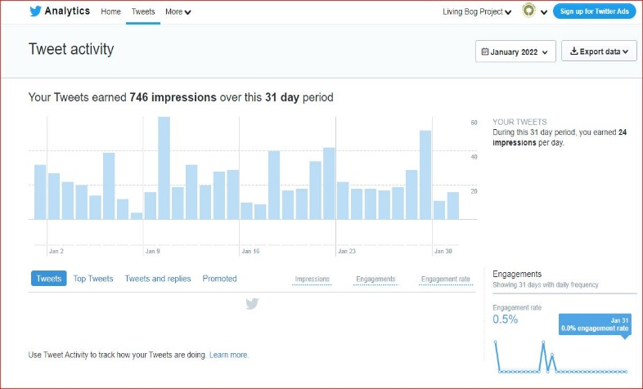
2017
2020
Yearly analysis of Twitter activity based on January each project year
2018
2021
2019
2022

Slide 12
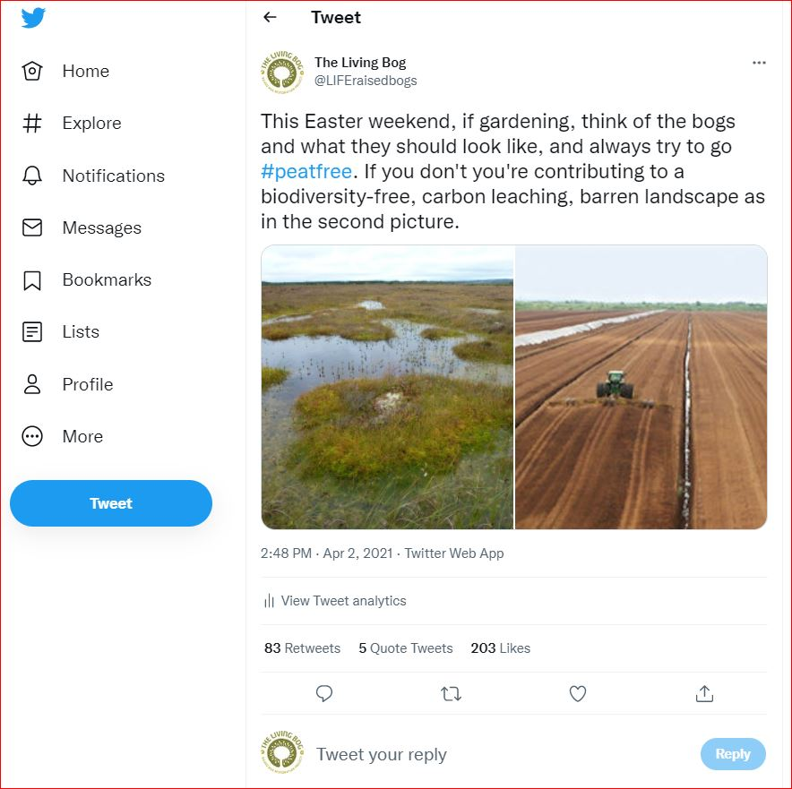
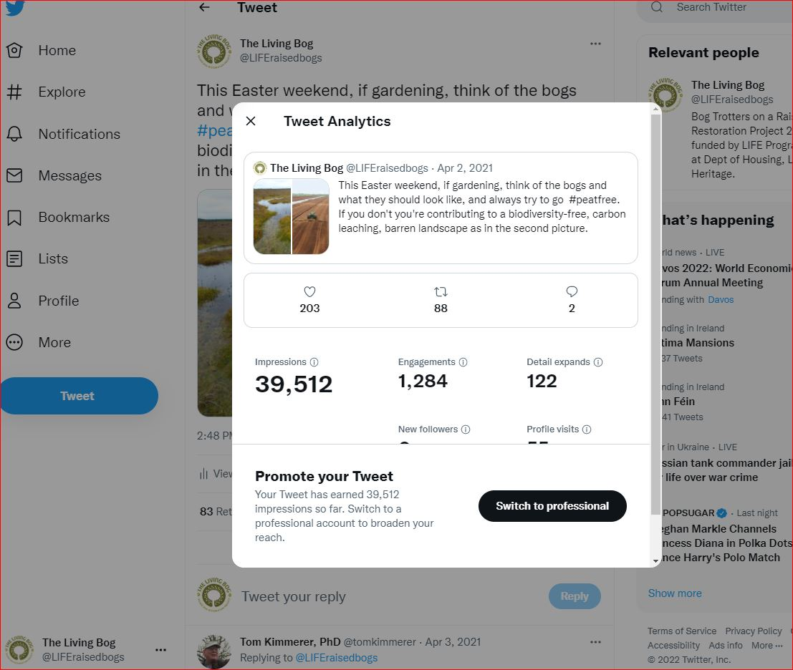
Twitter overview Apr 2021

Slide 13
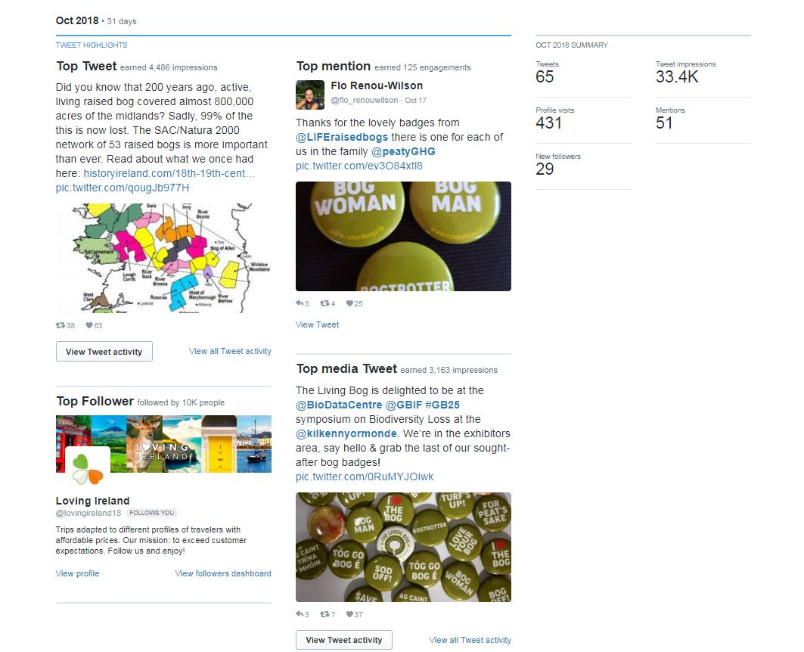
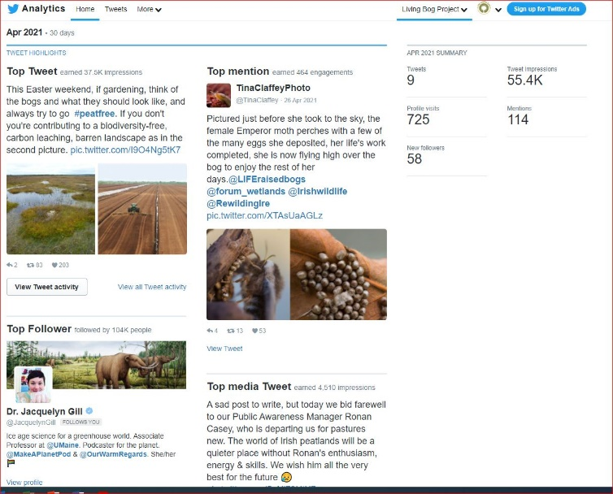
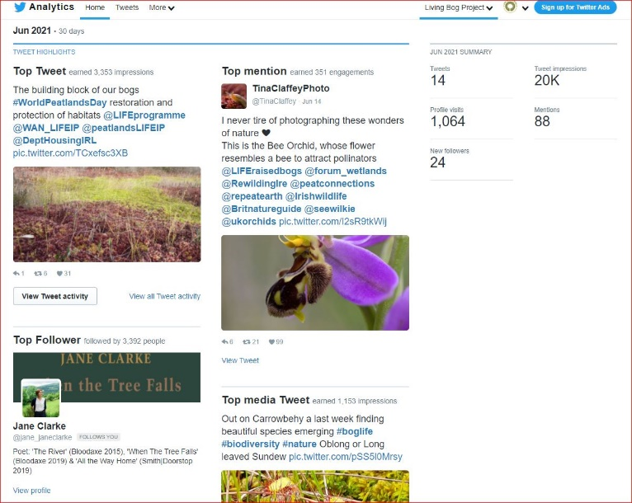
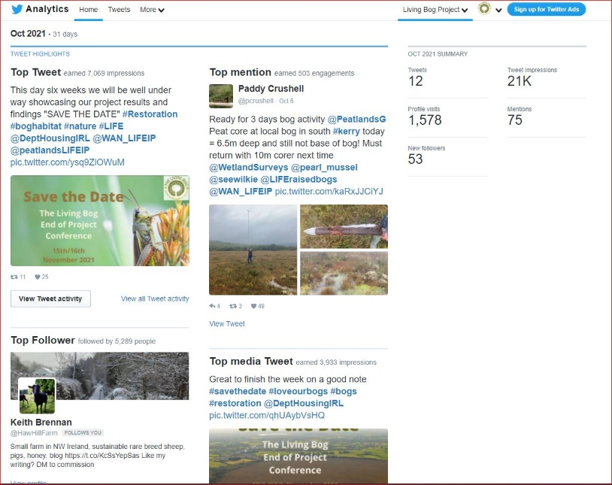
Twitter overview Oct 2018,
Apr 2021, Jun, 2021
& Oct 2021

Slide 14
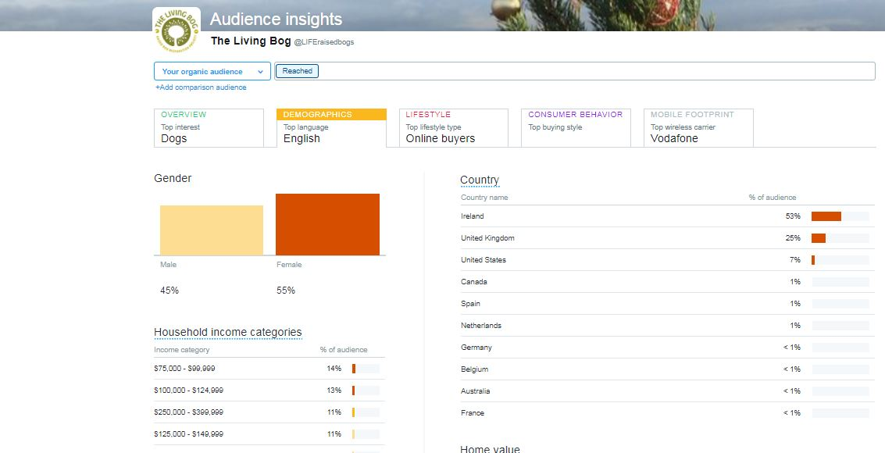
Twitter audience breakdown – no further update – removed from analytics Jan 2020

Slide 15
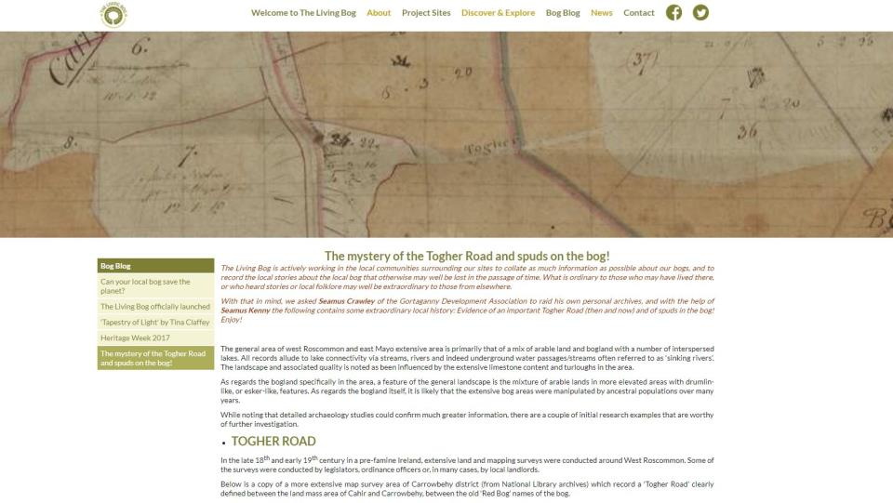

Slide 16
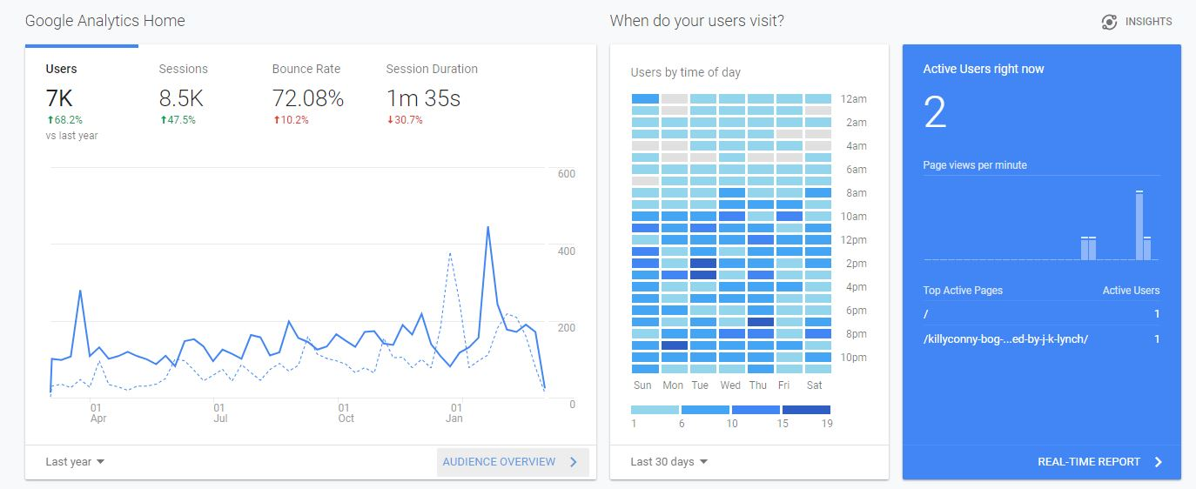

Slide 17
